Slide 1
NextGenCart: Shopping Made Smart and Simple
Team 10
Shrinidhi 01fe22bar015
Nandeesh 01fe22bar020
Vijay Totakar 01fe22bar023
Shwetha 01fe22bar042
Koushik 01fe23bar413

Slide 2
Theme: Automation for Human Well-Being.
Problem Identification:
Supermarkets face challenges like long checkout queues, manual barcode scanning errors, and customer inconvenience in navigating crowded aisles. Traditional shopping carts lack features like real-time billing updates, hands-free operation, and theft prevention. These inefficiencies highlight the need for a smart, automated solution to improve the shopping experience and operational efficiency.

Slide 3
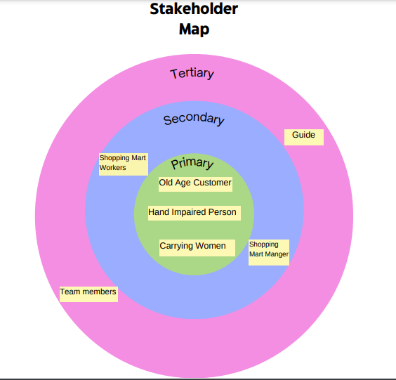
Design Thinking
Stakeholder Map: Identifies primary users (customers), secondary users (store staff), and tertiary stakeholders (Guide & Team members).

Slide 4
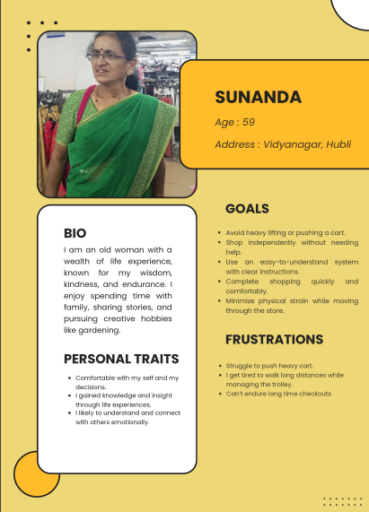
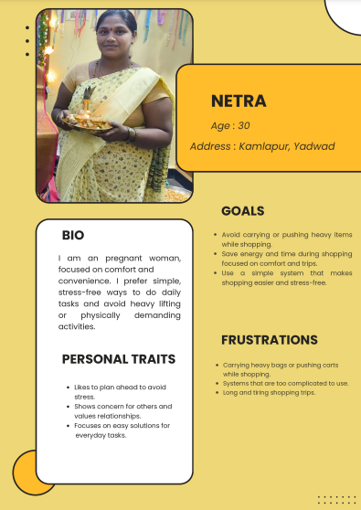
Design Thinking
Stakeholder Personas: Represents Stakeholders profiles to understand their needs and challenges.
Primary Stakeholders:

Slide 5
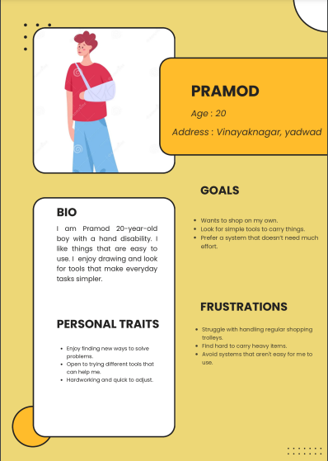
Design Thinking
Primary Stakeholders:

Slide 6
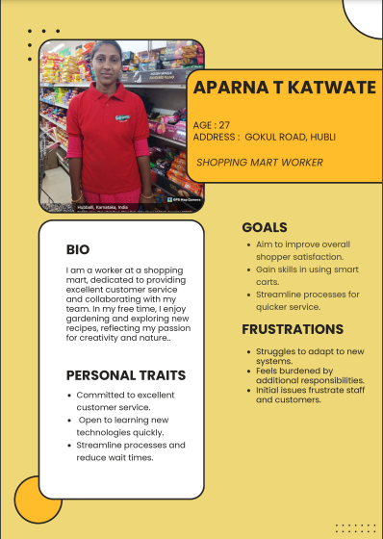
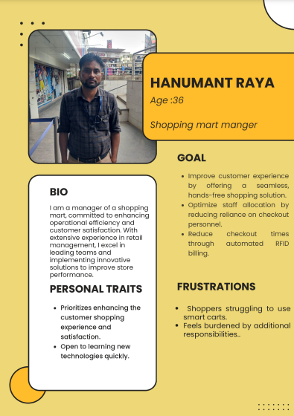
Design Thinking
Secondary Stakeholders:

Slide 7

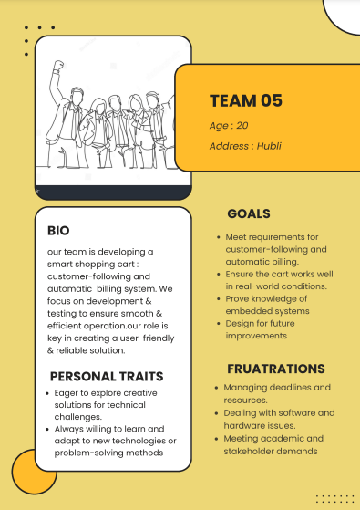
Design Thinking
Tertiary Stakeholders:

Slide 8
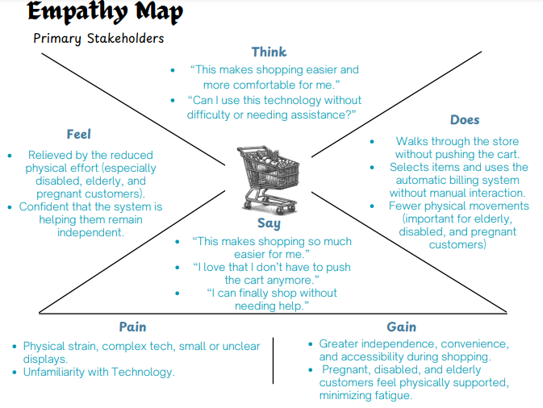
Design Thinking
Empathy Map: Captures customer perspectives—what they say, think, feel, and do during the shopping experience.

Slide 9
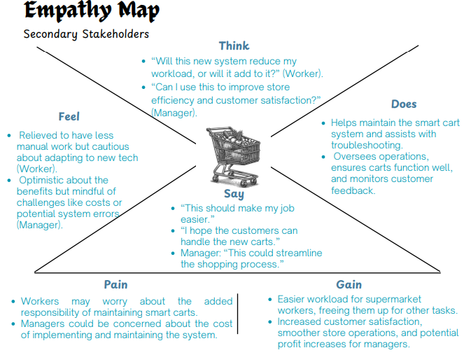
Design Thinking

Slide 10
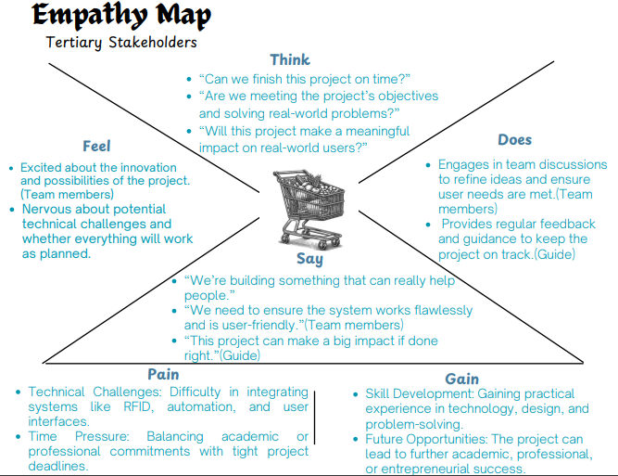
Design Thinking

Slide 11
Design Thinking
User Needs:
SL NO | Need Statements
1 | The customer needs a shopping cart that can be controlled seamlessly through a mobile application.
2 | The customer needs a cart that identifies items using a scanner as they are added to the cart
3 | The customer needs a cart that displays the total bill in real-time on the screen.
4 | The customer needs a cart that eliminates the need for manual scanning at checkout.
5 | The customer needs a shopping cart that requires minimal human interaction.
6 | The customer needs a cart that syncs with the app to provide alerts if they move too far from the cart.
7 | The customer needs a cart that can detect obstacles and navigate around them safely.
8 | The customer needs a cart that functions smoothly and provides a jerk-free shopping experience.
9 | The customer needs a shopping cart that alerts them to expired or recalled products because it ensures safe purchases.
10 | The customer needs a cart that must allow misadded item removal.
11 | The customer needs a cart that is energy-efficient to support longer shopping sessions.

Slide 12
Design Thinking
12 | The customer needs a cart that helps reduce wait times at checkout.
13 | The customer needs a cart with a large, easy-to-read display for convenient bill viewing.
14 | The customer needs a cart that can accommodate different item weights and sizes while maintaining balance.
15 | The customer needs a cart that can navigate various floor types (carpet, tile, etc.) smoothly.
16 | The customer needs a cart that navigates according to shopping mart map.
17 | The customer needs a cart that offers a user-friendly, intuitive shopping experience.
18 | The customer needs a cart that shall alert the customer if they add repeated items to the cart, unknowingly.
19 | The customer needs a cart that can log and display each added item’s price and quantity.
20 | The user needs a cart that should allow real-time tracking of total weight in the cart.
21 | The customer needs a cart that should automatically stop if it detects an obstacle.
22 | The customer needs a cart that adjusts its lighting automatically in dim or dark areas of the store.
23 | The customer needs a cart that notifies the user of app alerts or instructions while shopping.
24 | The customer requires a cart that automatically adjusts its height to match the height of the rack.

Slide 13
Design Thinking
25 | The customer needs a cart that uses a reader module for efficient item detection and billing.
26 | The customer needs a cart that provides reminders or notifications if items remain unscanned.
27 | The customer needs a cart that alerts them if unauthorized item removal is detected.
28 | The customer needs a cart that allows users to set a spending limit or budget.
29 | The customer needs a shopping cart that allows easy removal of unwanted items because it helps them modify their purchase before checkout.
30 | The customer needs a cart that is compact yet stable for ease of navigation in narrow aisles.
31 | The customer needs a cart that has durable, lightweight materials to ensure easy handling.
32 | The customer needs a shopping cart that securely processes payments directly because it reduces the need to wait at the register.
33 | The customer needs a cart that adds items to the cart by itself through voice command.
34 | The customer needs a cart with sustainable and recyclable materials to align with environmental standards.
35 | The customer needs a cart with a modern design that aligns with store aesthetics.
36 | The customer needs a cart with secure housing for sensors and electronics to prevent damage.
37 | The customer needs a cart that consumes minimal power for an extended battery life.

Slide 14
Design Thinking
38 | The customer needs a cart that autonomously follows the customer.
39 | The customer needs a cart that can be assembled, disassembled, and maintained easily.
40 | The cart must have smooth edges and easy-to-grip handles to keep users safe.

Slide 15
Engineering Design
Generating requirements:
SL NO | Requirements
1 | The cart must be controlled through mobile application.
2 | The cart must identify the purchased items automatically.
3 | The cart must show the total bill in real-time.
4 | The cart must eliminate manual scanning checkout.
5 | The cart should cost less than Rs 5000.
6 | The cart must alert the user if they move far away.
7 | The cart must detect obstacles and stop to ensure safety.
8 | The cart must alert the customer if they unknowingly add repeated items.
9 | The cart must function effectively and jerk-free.
10 | The cart shall allow to remove unwanted items from the cart easily.
11 | The cart should be energy efficient to support extended shopping trips.
12 | The cart must minimize the need to wait at the checkout centre.
13 | The cart should be user-friendly.

Slide 16
Engineering Design
14 | The customer needs a shopping cart that requires minimal human interaction.
15 | The cart should have less maintenance.
16 | The cart should be easy to operate with minimal setup.
17 | The cart must scan items when placed in or removed from the cart.
18 | The cart shall navigate in different floor types.
19 | The cart must ensure the hassle-free shopping experience.
20 | The cart shall identify expired products and alert the customer.
21 | The cart must carry different weights and sizes without losing balance.
22 | The cart should adjust its lighting in dark or dimly lit sections of the store.
23 | The cart must be easy to use.
24 | The cart must have a clear display for ease.
25 | The cart must allow customer to manage their shopping budget.
26 | The cart should alert when unauthorized item removal occurs.
27 | The cart should autonomously follow the customer.
28 | The cart should automatically adjust its height to match the rack’s height.

Slide 17
Engineering Design
 | Designer Requirements
29 | The cart must be easy to put together, take apart, and fix.
30 | The cart must be small enough to move around easily while staying stable.
31 | The cart must be made from materials that are light but still strong and long-lasting.
32 | The cart must have a modern design that looks good and fits in with the store.
33 | The cart must have secure housing for sensors & electronics to prevent damage.
34 | The cart wheels should move smoothly without bumps or jerks.
35 | The cart must have smooth edges and easy-to-grip handles to keep users safe.
36 | The cart must possess sustainable and recyclable materials.
37 | The wires and cables of cart should be concealed for a clean look.

Slide 18
Engineering Design
Demands and Wishes:
SL NO | Need Statements | Demands/Wishes
1 | The customer needs a shopping cart that can be controlled seamlessly through a mobile application. | Demand
2 | The customer needs a cart that identifies items using a scanner as they are added to the cart. | Demand
3 | The customer needs a cart that displays the total bill in real-time on the screen. | Demand
4 | The customer needs a cart that eliminates the need for manual scanning at checkout. | Demand
5 | The customer needs a shopping cart that requires minimal human interaction. | Demand
6 | The customer needs a cart that syncs with the app to provide alerts if they move too far from the cart. | Wish
7 | The customer needs a cart that can detect obstacles and navigate around them safely. | Wish
8 | The customer needs a cart that functions smoothly and provides a jerk-free shopping experience. | Demand
9 | The customer needs a shopping cart that alerts them to expired or recalled products because it ensures safe purchases. | Wish
10 | The customer needs a cart that must allow misadded item removal. | Demand

Slide 19
Engineering Design
11 | The customer needs a cart that is energy-efficient to support longer shopping sessions. | Demand
12 | The customer needs a cart that helps reduce wait times at checkout. | Demand
13 | The customer needs a cart with a clear, easy-to-read display for convenient bill viewing. | Demand
14 | The customer needs a cart that can accommodate different item weights and sizes while maintaining balance. | Demand
15 | The customer needs a cart that can navigate various floor types (carpet, tile, etc.) smoothly. | Demand
16 | The customer needs a cart that navigates according to shopping mart map. | Wish
17 | The customer needs a cart that offers a user-friendly, intuitive shopping experience. | Demand
18 | The customer needs a cart that shall alert the customer if they add repeated items to the cart, unknowingly. | Demand
19 | The customer needs a cart that can log and display each added item’s price and quantity on the screen | Demand
20 | The user needs a cart that should allow real-time tracking of total weight in the cart. | Wish
21 | The customer needs a cart that should automatically stop if it detects an obstacle. | Demand

Slide 20
Engineering Design
22 | The customer needs a cart that adjusts its lighting automatically in dim or dark areas of the store. | Wish
23 | The customer needs a cart that notifies the user of app alerts or instructions while shopping. | Wish
24 | The customer requires a cart that automatically adjusts its height to match the height of the rack. | Wish
25 | The customer needs a cart that uses a scanner for efficient item detection and billing. | Demand
26 | The customer needs a cart that provides reminders or notifications if items remain unscanned. | Wish
27 | The customer needs a cart that alerts them if unauthorized item removal is detected. | Wish
28 | The customer needs a cart that allows users to set a spending limit or budget via the app. | Wish
29 | The customer needs a shopping cart that allows easy removal of unwanted items because it helps them modify their purchase before checkout. | Wish
30 | The customer needs a cart that is compact yet stable for ease of navigation in narrow aisles. | Demand
31 | The customer needs a cart that has durable, lightweight materials to ensure easy handling. | Demand

Slide 21
Engineering Design
32 | The customer needs a shopping cart that securely processes payments directly because it reduces the need to wait at the register | Demand
33 | The customer needs a cart that adds items to the cart by itself through voice command. | Wish
34 | The customer needs a cart with sustainable and recyclable materials to align with environmental standards. | Wish
35 | The customer needs a cart with a modern design that aligns with store aesthetics. | Wish
36 | The customer needs a cart with secure housing for sensors and electronics to prevent damage. | Demand
37 | The customer needs a cart that consumes minimal power for an extended battery life. | Demand
38 | The customer needs a cart that autonomously follows the customer. | Wish
39 | The customer needs a cart that can be assembled, disassembled, and maintained easily | Wish
40 | The cart must have smooth edges and easy-to-grip handles to keep users safe. | Demand

Slide 22
Engineering Design
Sorting Requirements:
Functional Requirements:
1. Cart Following Mechanism
Customer Tracking: The cart must follow the customer.
Safe Distance Maintenance: The cart must maintain a safe distance from the customer during operation.
Speed Matching: The cart must automatically match the walking speed of the customer.
The cart must automatically stop when the customer stops
2. Item Detection and Billing
Automatic Item Identification: The cart must identify purchased items automatically.
Real-time Billing: The cart must show the total bill in real-time.
Item Removal: The cart must allow easy removal of unwanted items.

Slide 23
Engineering Design
Requirements of stakeholders :
1 User Alerts and Notifications
Repeated Item Notification: The cart shall notify the customer if they add repeated items to the cart
Expired Product Detection: The cart shall identify expired products and alert the customer.
2 Energy and Efficiency
Energy Efficiency: The cart should be energy efficient to support extended shopping trips.
Autonomous following: The cart must operate completely hands-free so customers can focus on shopping.

Slide 24
Engineering Design
System requirements :
1. Energy and Efficiency
Energy Efficiency: The cart should be energy efficient to support extended shopping trips.
Low Maintenance: The cart should require minimal maintenance.
2. User Interface and Design
Large Display: The cart must have a large, clear display for ease of use.
Lighting Adjustment: The cart should adjust its lighting in dark or dimly lit sections of the store.

Slide 25
Engineering Design
System technical requirements :
1. Structural and Design Considerations
Compact and Stable Design: The cart must be small enough to move around easily while staying stable.
Durable Materials: The cart must be made from materials that are light but still strong and long-lasting.
Modern Aesthetic: The cart must have a modern design that looks good and fits in with the store.
Organized Wiring: The wires and cables should be neatly hidden inside the cart to keep them organized and out of sight.

Slide 26
Engineering Design
Logical Requirements:
Obstacle Detection
The cart must detect and avoid obstacles during operation.
Secure Payment Processing
The cart must integrate with a secure payment gateway for transaction processing.

Slide 27
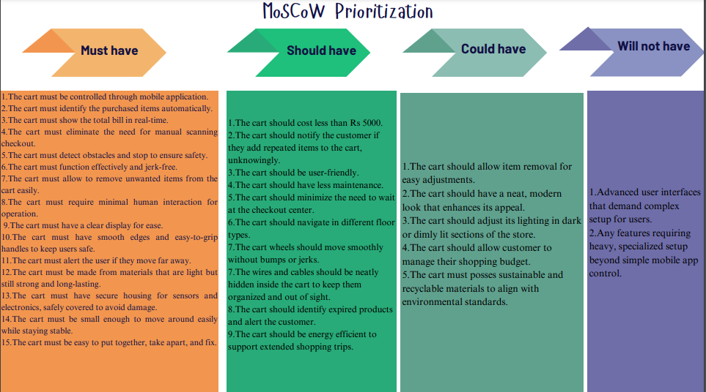
Engineering Design
MoSCoW Prioritization:

Slide 28
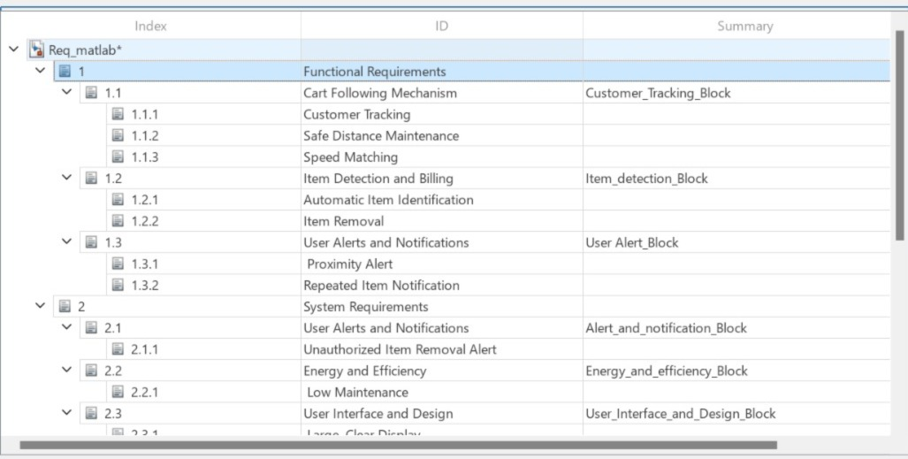
MATLAB Requirement tool box

Slide 29
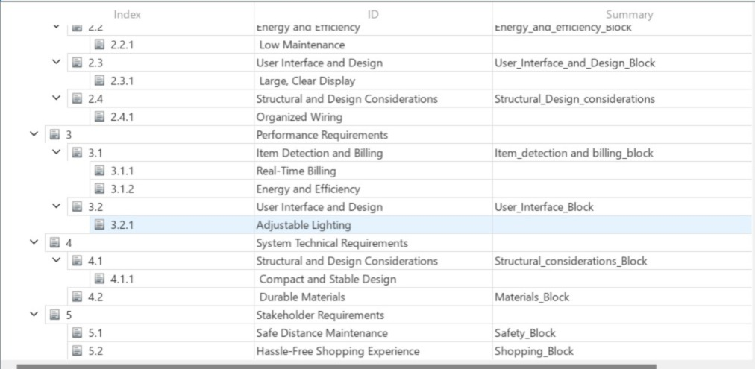
MATLAB Requirement tool box

Slide 30
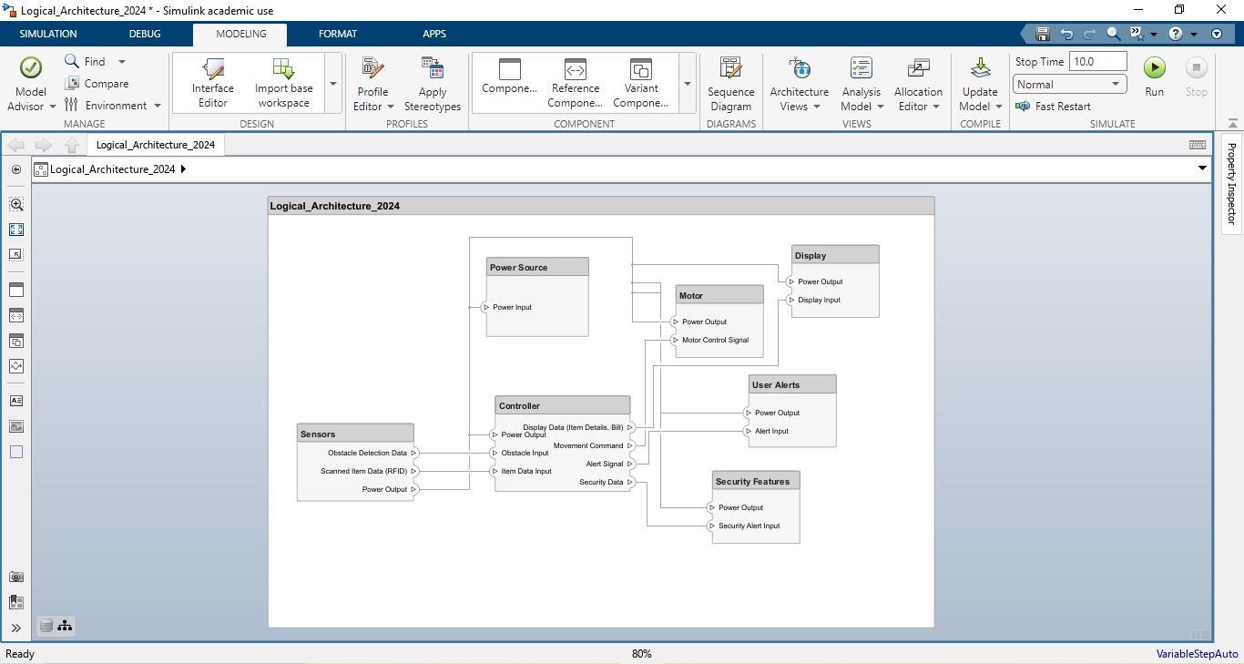
Architecture
Logical Architecture:

Slide 31
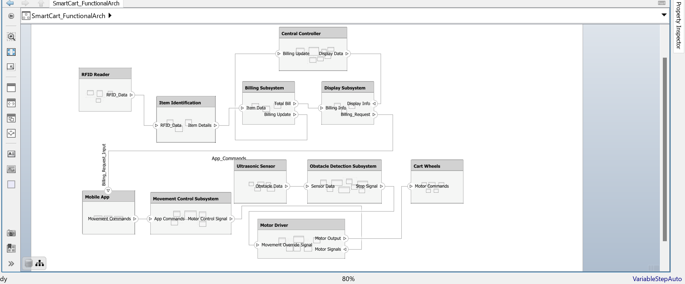
Architecture
Functional Architecture:

Slide 32

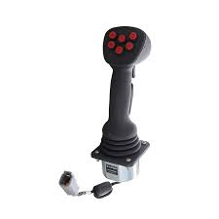
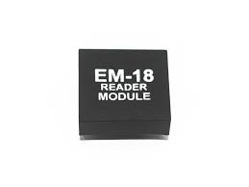
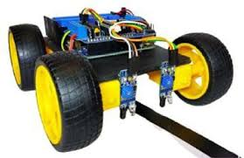
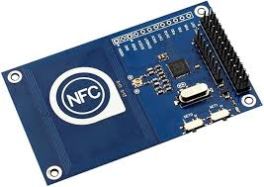
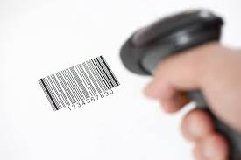
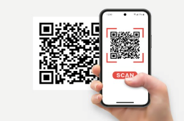
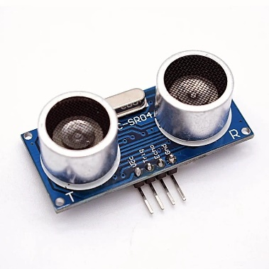
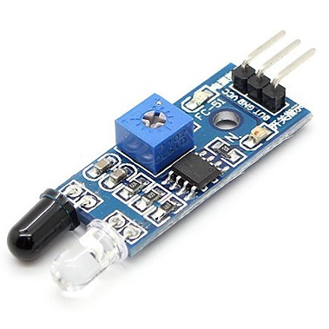
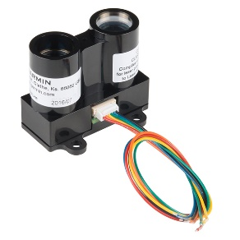

Morphological Chart
SI NO | SUB-FUNCTIONS | MEAN 1 | MEAN 2 | MEAN 3 | MEAN 4
1. | Movement control | Mobile application | RFID-Based navigation | Joystick-based control | Line Following
2. | Item Scanning | RFID Reader module | NFC Reader module | Barcode Scanning | QR Code Scanning
3. | Obstacle detection | Ultrasonic sensor | IR sensor | LIDAR | Camera-Based Vision

Slide 33
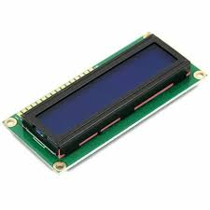

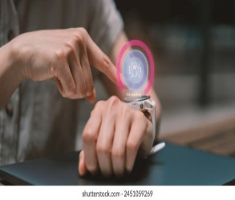
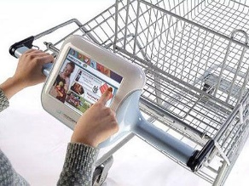
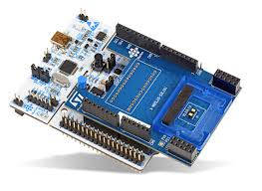
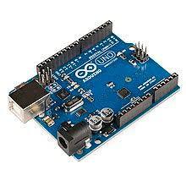
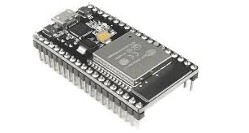
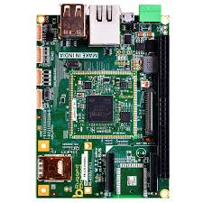
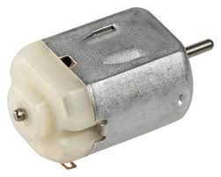
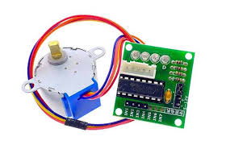
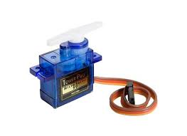
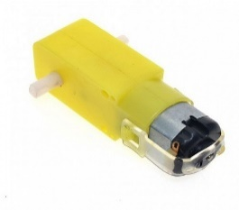
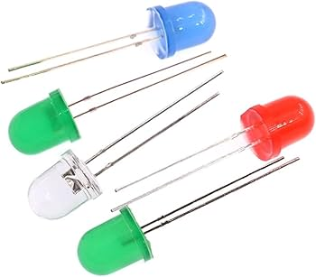
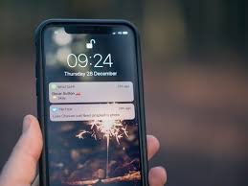
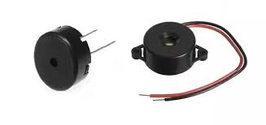

Morphological Chart
4. | User Interface | LCD Display | Mobile application | Touchscreen Display | Smartwatch interface
5. | Controlling unit | STM32 | ESP32 | Rugged board | Arduino
6. | Actuation | DC Motor | Stepper Motor | Servo Motor | Gear Motor
7. | User alert | LED Indicators | Mobile App Notifications | Beeping Sounds | Voice Prompts

Slide 34
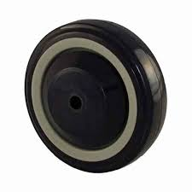
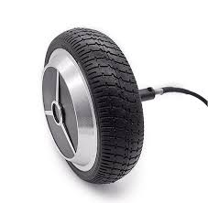
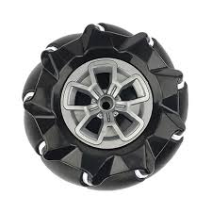
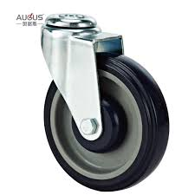
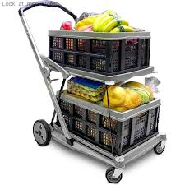
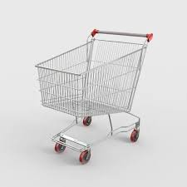
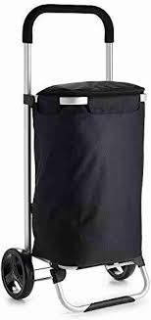
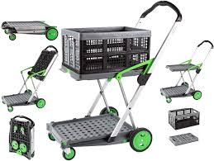
Morphological Chart
8. | Mobility | Standard Wheels | Motorized Wheels | Omnidirectional Wheels | Castor wheel
9. | Item storage | Multiple Compartments | Foldable/Expandable Storage | Standard storage | Bagging Storage

Slide 35
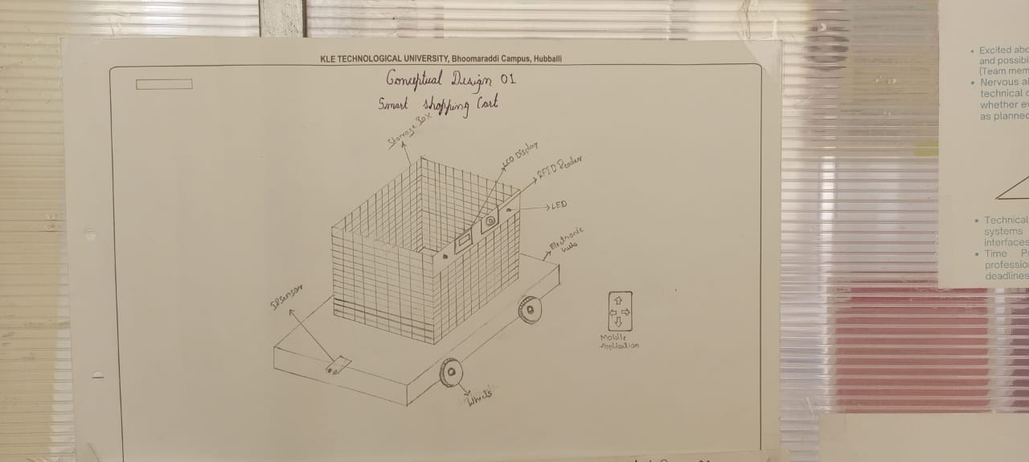
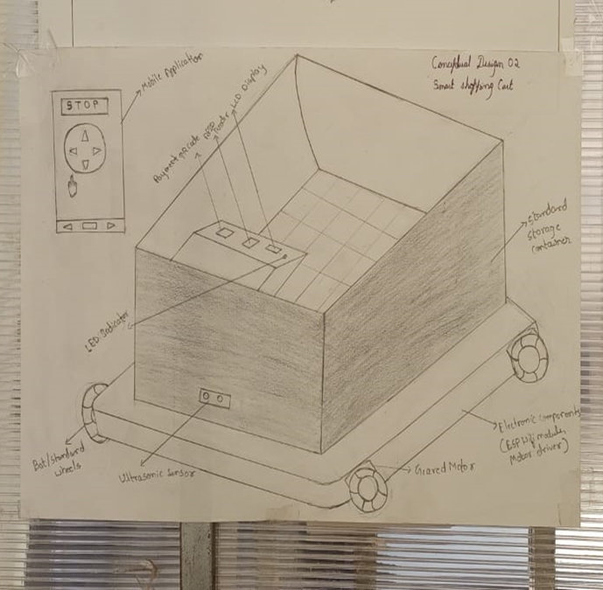
Conceptual Design
Conceptual Design:01
Conceptual Design:02

Slide 36
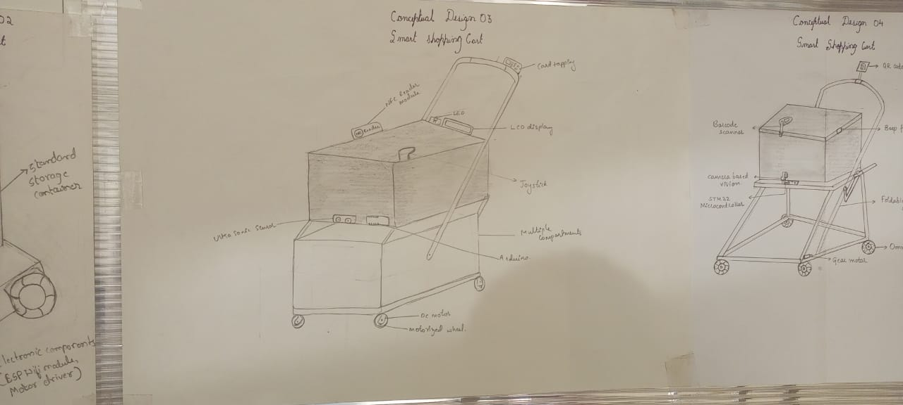
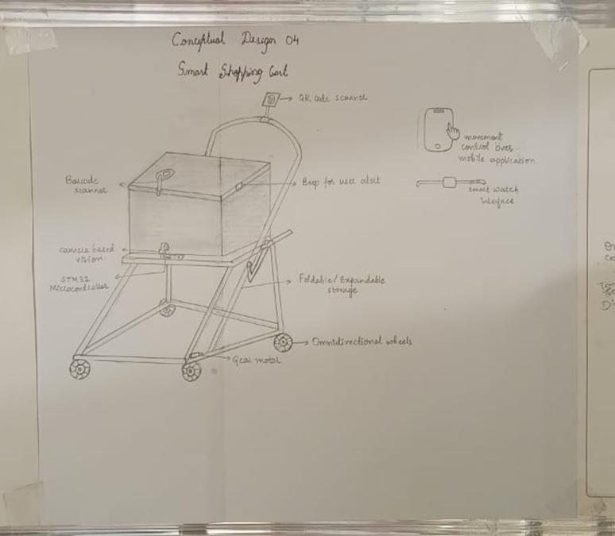
Conceptual Design
Conceptual Design:03
Conceptual Design:04

Slide 37

Conceptual Design
Conceptual Design:05

Slide 38

Concept Screening

Slide 39
Concept Screening
Design Objectives | Weights (%) | Design 1 | Score | Design 2 | Score | Design 3 | Score | Design 4 | Score | Design 5 | Score
Ease of use | 14 | 4 | 0.56 | 5 | 0.70 | 5 | 0.70 | 5 | 0.70 | 5 | 0.7
Portability | 8 | 2 | 0.16 | 4 | 0.32 | 3 | 0.24 | 3 | 0.24 | 2 | 0.16
Use of standard parts | 10 | 5 | 0.5 | 5 | 0.5 | 5 | 0.5 | 4 | 0.4 | 5 | 0.5
Cost | 11 | 4 | 0.44 | 5 | 0.55 | 3 | 0.33 | 5 | 0.55 | 4 | 0.44
Safety | 13 | 5 | 0.65 | 5 | 0.65 | 5 | 0.65 | 5 | 0.65 | 4 | 0.52
Accuracy | 14 | 5 | 0.70 | 5 | 0.70 | 5 | 0.70 | 5 | 0.70 | 5 | 0.70
Reliability | 13 | 5 | 0.65 | 5 | 0.65 | 5 | 0.65 | 5 | 0.65 | 4 | 0.52
Power Efficiency | 8 | 4 | 0.32 | 4 | 0.32 | 4 | 0.32 | 3 | 0.24 | 2 | 0.16
Total Score |  |  | 3.98 |  | 4.39 |  | 2.94 |  | 4.13 |  | 3.7
Rank |  |  | 3 |  | 1 |  | 5 |  | 2 |  | 4

Slide 40

Detailed Design of Finalized concept

Slide 41


Detailed Design of Finalized concept

Slide 42

Flow chart

Slide 43

BOM(Bill of Materials)

Slide 44

Circuit Design

Slide 45


Prototyping
Independent Entity Images
Basket
Frame

Slide 46


Independent Entity Images
Electrical Hub
Geared DC Motor

Slide 47


Independent Entity Images
LCD Display(16*2)
RFID Reader Module

Slide 48



Independent Entity Images
Ultrasonic Sensor
Wheel
Buzzer

Slide 49
THANK YOU

